Slide 1
Course : T7043 – IT Services
Period : February 2018
Capacity Planning
Session 08
D5664 – Dr. Eng. Antoni Wibowo

Slide 2
Informasi yang dibutuhkan Manajemen
  Number of Escalations
  Process Improvements
  Process Compliance
  Percentage of Report Request Entitlement Failures
  Performance/Capacity
  Trending in Problem/Change Ticket resolution
  Call Center Metrics
  SLA Compliance
Bina Nusantara

Slide 3
Performance and Capacity Management Activities include:
Performance monitoring
Tuning activities
Demands on the current and future busines
Influences
Capacity planning
Bina Nusantara

Slide 4
Performance Management
Performance Management consists of applying skills and techniques for the purpose of optimizing the performance of computing system resources
Bina Nusantara

Slide 5
Non Functional Requirement
Non-functional requirements, or constraints that are a hindrance to delivering the functional requirements in an enterprise
Some examples of Non Functional requirements include:
  Performance
  Availability
  Maintainability
  Testability
  Portability
  Security
  NLS (National Language Support)
Bina Nusantara

Slide 6
Performance Constraint
Constraints include:
  Geographical
  Technical standards
  Government standards
  Existing IT environment
Bina Nusantara

Slide 7
Capacity Management
Capacity Management is the discipline concerned with ensuring adequate computing system resources availability to meet demands of end users, applications, and any other need supported by the IT enterprise meeting a business requirement.
Bina Nusantara

Slide 8
Possible Infrastructure Service Interconnections with Performance and Capacity Management include:
Configuration Management
Event Management
Operations Management
Availability Management
Inventory
Business Process Management
Resource Management (w/ Utility Computing)
Bina Nusantara

Slide 9
Possible Relationship Service Interconnections with Performance and Capacity Management include:
Reporting Management
SLA Management
Knowledge Management
Asset Management
Notification and Escalation Management
Problem Management
Change Management
Bina Nusantara

Slide 10
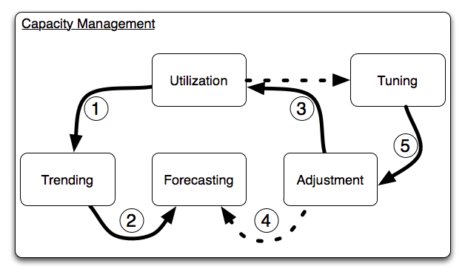
CAPACITY PLANNING
Bina Nusantara

Slide 11
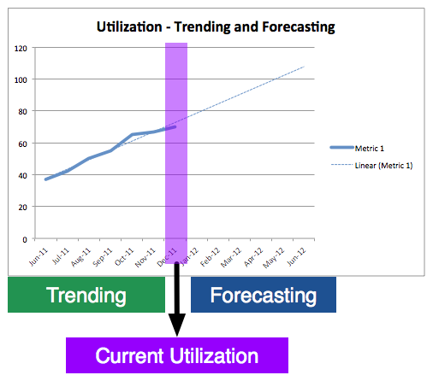
Trending & forcasting
Bina Nusantara

Slide 12
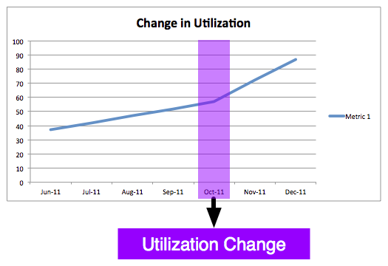
Bina Nusantara

Slide 13
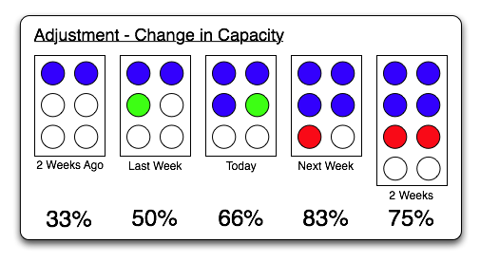
Bina Nusantara

